Slide 1
Analysis of the 2008 NFL Season
Nathaniel Ginck

Slide 2


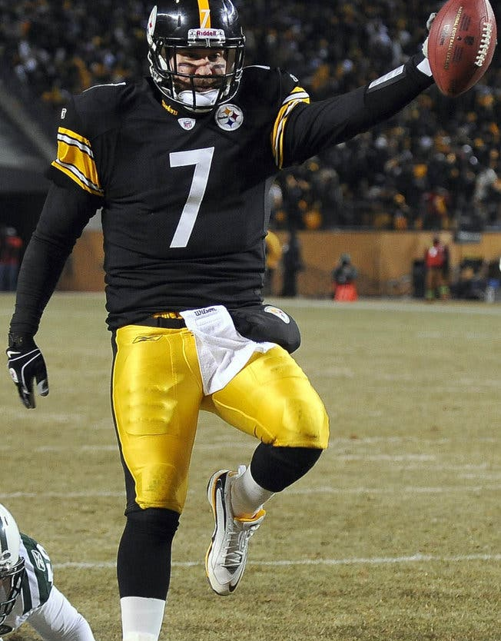
Season Overview and Format
In the 2008 season, the Steelers won their division and the Super Bowl XLIII over the Arizona Cardinals. I am interested in seeing if the Steelers do as well in the simulated model. Additionally, the Detroit Lions finished 0-16, and I am curious if they will do as poorly in the Monte Carlo simulation.
At this point in the league, there are 32 teams with 2 conferences: the AFC and the NFC. Each conference has 4 divisions with four teams, based loosely on location. The leader of each division go on to play in the post season, with the two next best teams in the AFC and NFC also qualifying.

Slide 3
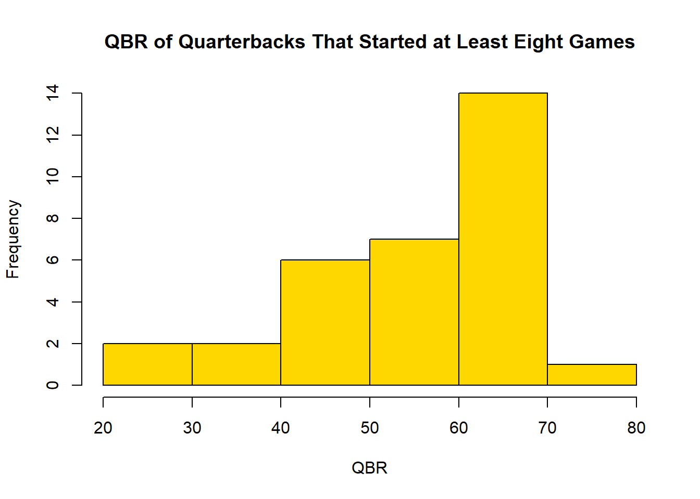
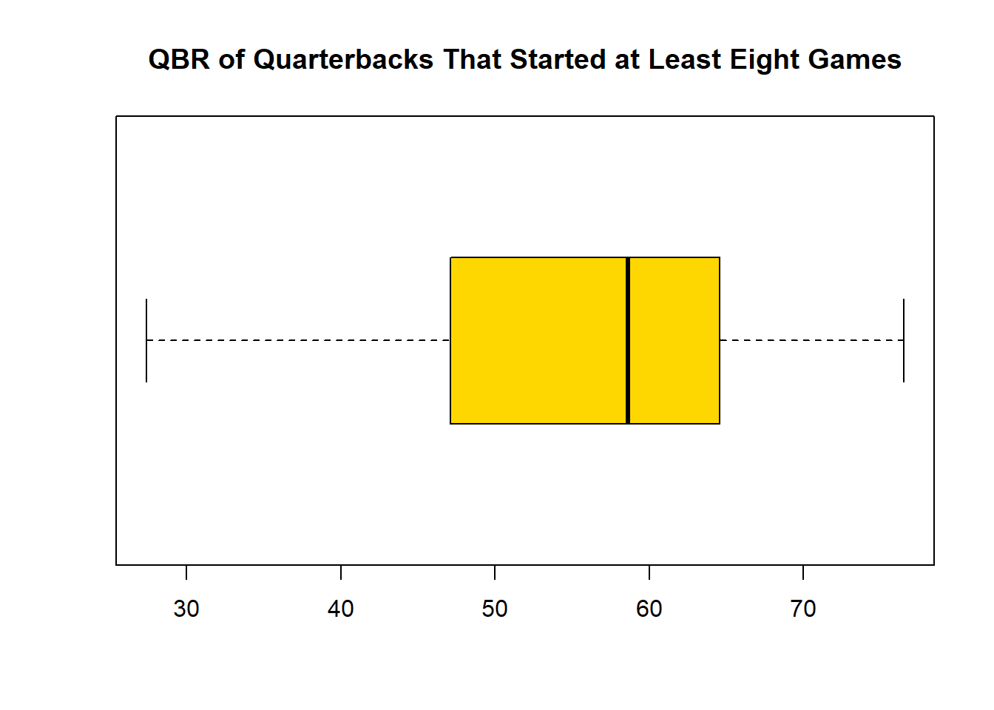
Statistical Summary of Relevant Statistics
For Quarterbacks that started in at least half the season, the median QBR was 61.05
The minimum QBR was 27.4, which belonged to the 49er’s J.T. O’Sullivan
The maximum QBR was 76.5, which belonged to the Colt’s Peyton Manning

Slide 4
Discussion of Relevant Statistics
The distribution of QBR were right skewed, with a mean of 55.5, and a standard deviation of 12.3. This result makes sense, as QBR is a measure of quarterback ranking, and worse quarterbacks usually don’t keep their starting position. For the two quarterbacks that played in the Super Bowl, Kurt Warner and Ben Roethlisberger, they had QBRs of 68.5 and 47.1 respectively, meaning Warner had a 1.7 standard deviation better QBR than Roethlisberger.
Out of the four quarterbacks with the best regular season record, 12-4, Ben Roethlisberger of the Steelers held the lowest QBR of the bunch, followed by Jake Delhomme at 55.5, then Eli Manning at 66.9, and Peyton Manning at 76.5. Ben Roethlisberger has an unusually low QBR for his performance; in the regular season he had a below average QBR and in the post season he was almost 2 standard deviations worse than the opposing team’s quarterback.

Slide 5
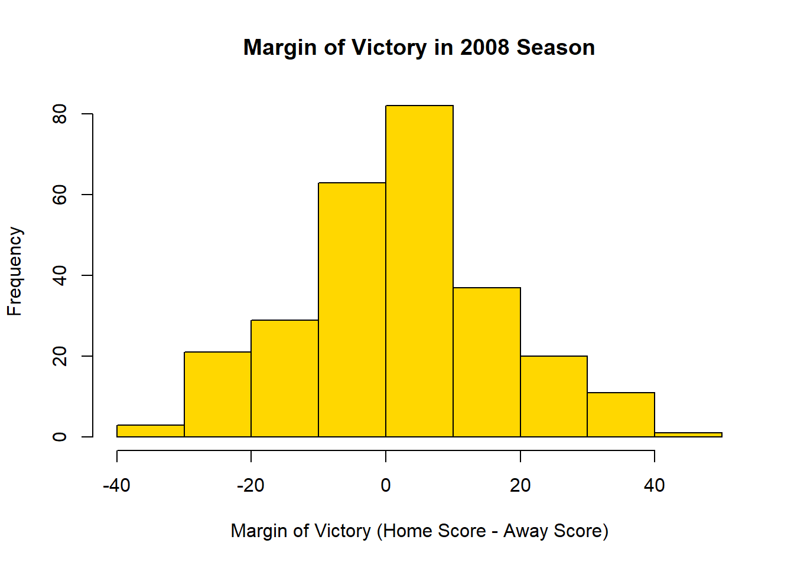
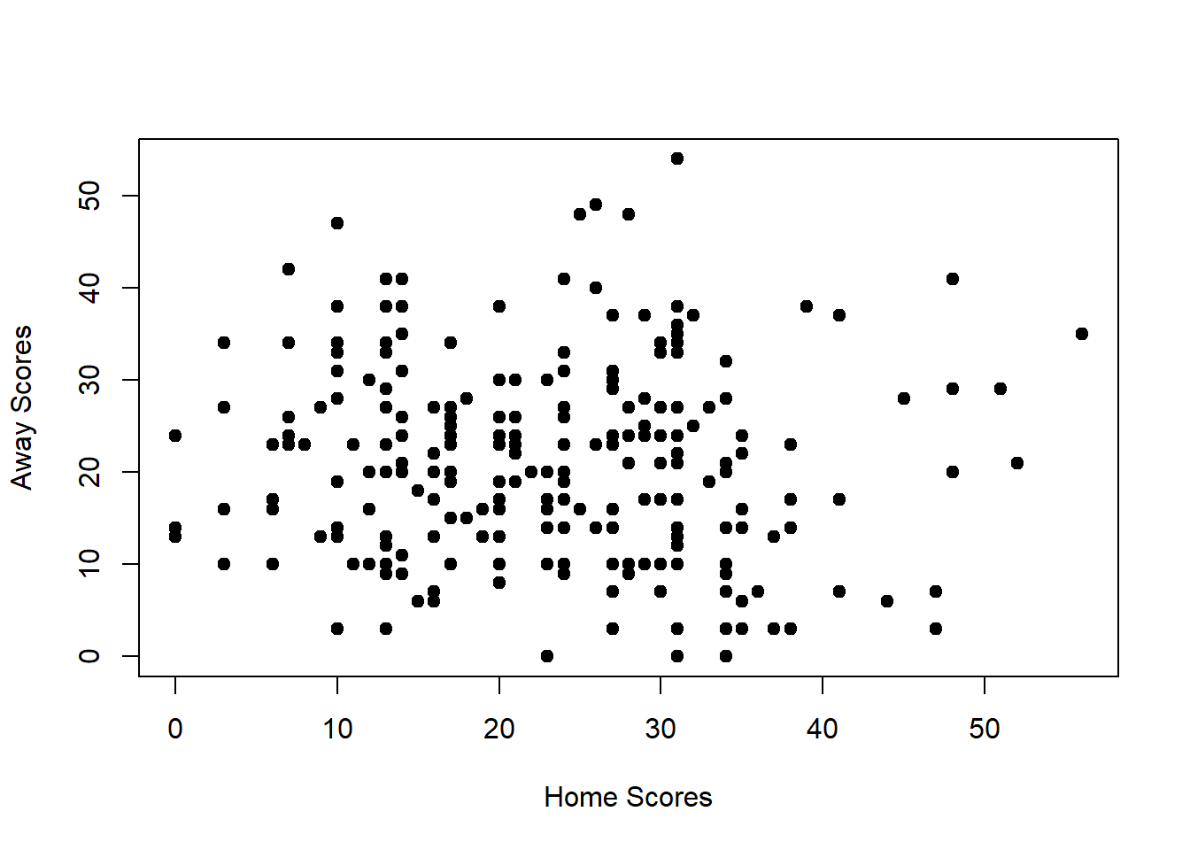
Creation of Scoring Distributions
The average home score was 23.2, with a standard deviation of 10.4
The average away score was 20.8, with a standard deviation of 10.3
The average margin of victory was 2.3, with a standard deviation of 15.2

Slide 6
Discussion of Scoring Distribution
The margin of victory scoring distribution is approximately normal, with an average of 2.3. This means that the home field advantage was worth 2.3 points on average in the 2008 season. Home and away scores are independent, as there is a correlation of -0.077 between these variables, and most scores take place between 10 and 30 points for both home and away teams. Home and away scores also have similar standard deviations, both slightly over 10 points. The lowest score was 0, which occurred 6 times, and the highest score was 56 points for a home team, and 54 for an away team.

Slide 7
Calculation of Pythagorean Win Percentages
The Pythagorean exponent constant was calculated only for the 2008 season and equaled 2.94
A half win was added to the Detroit Lions, who otherwise had a winless season. This was for the purpose of calculating the Pythagorean exponent. Their actual win percentage was used in the comparison
The following charts show each team‘s win percentage and Pythagorean win percentage separated by conference

Slide 8
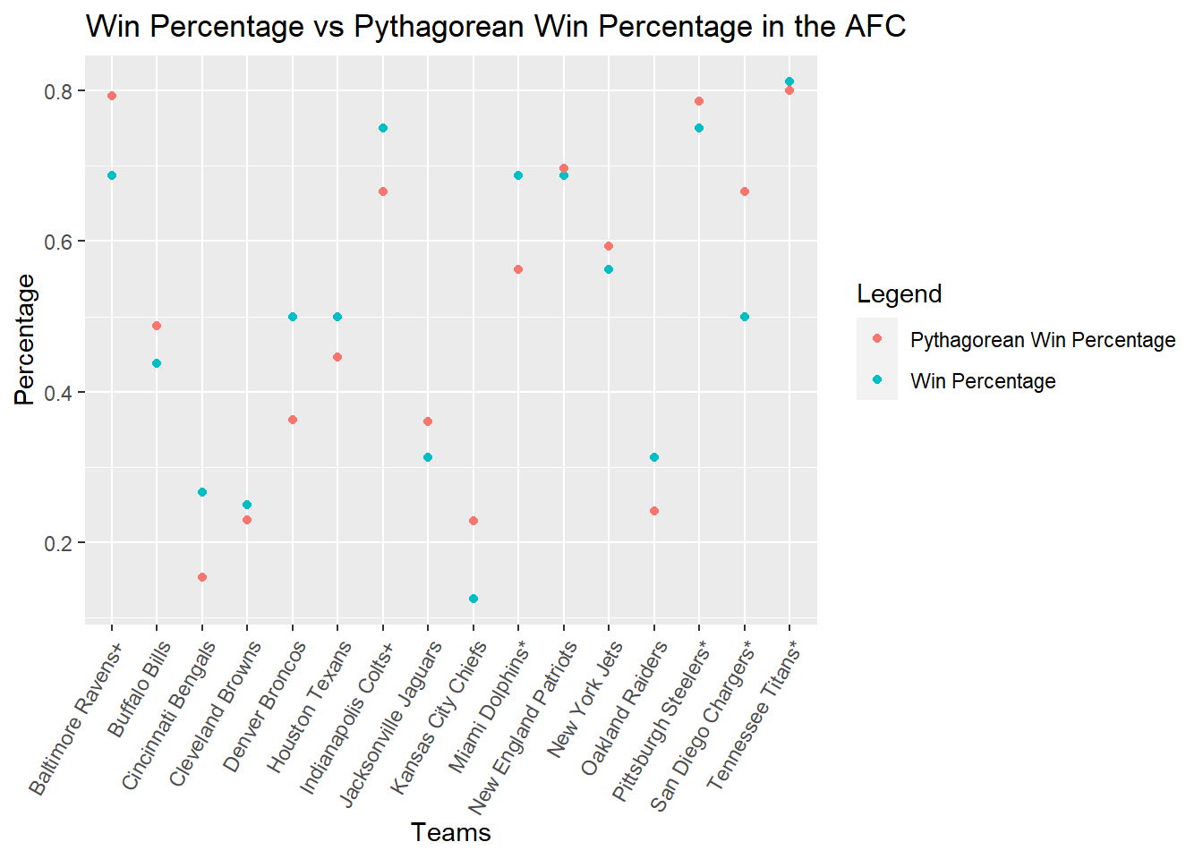
AFC

Slide 9
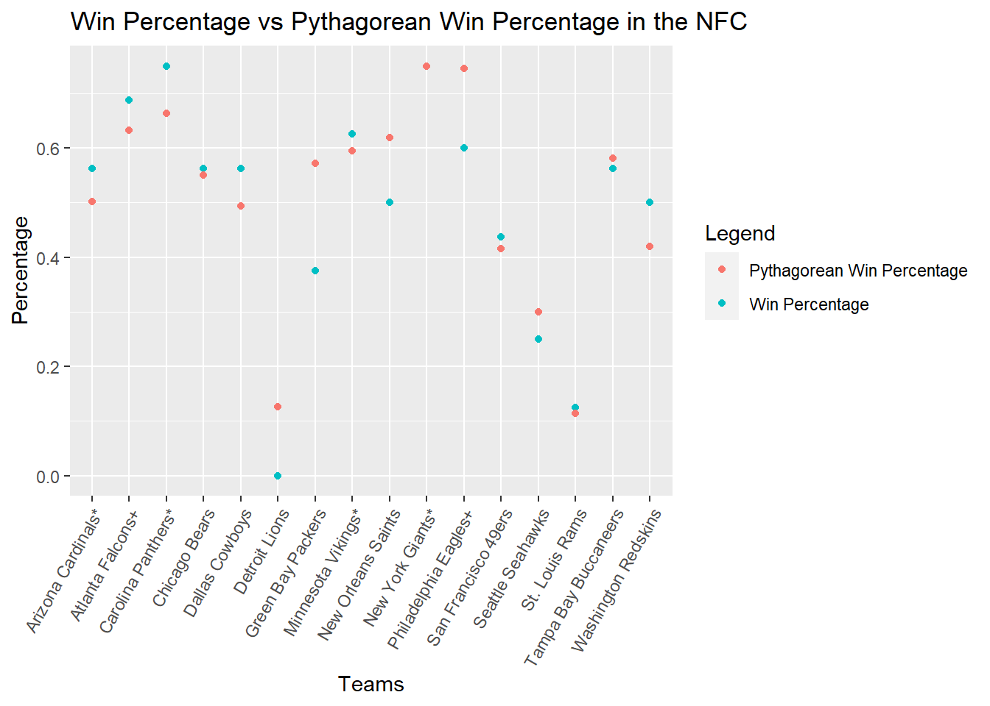
NFC

Slide 10
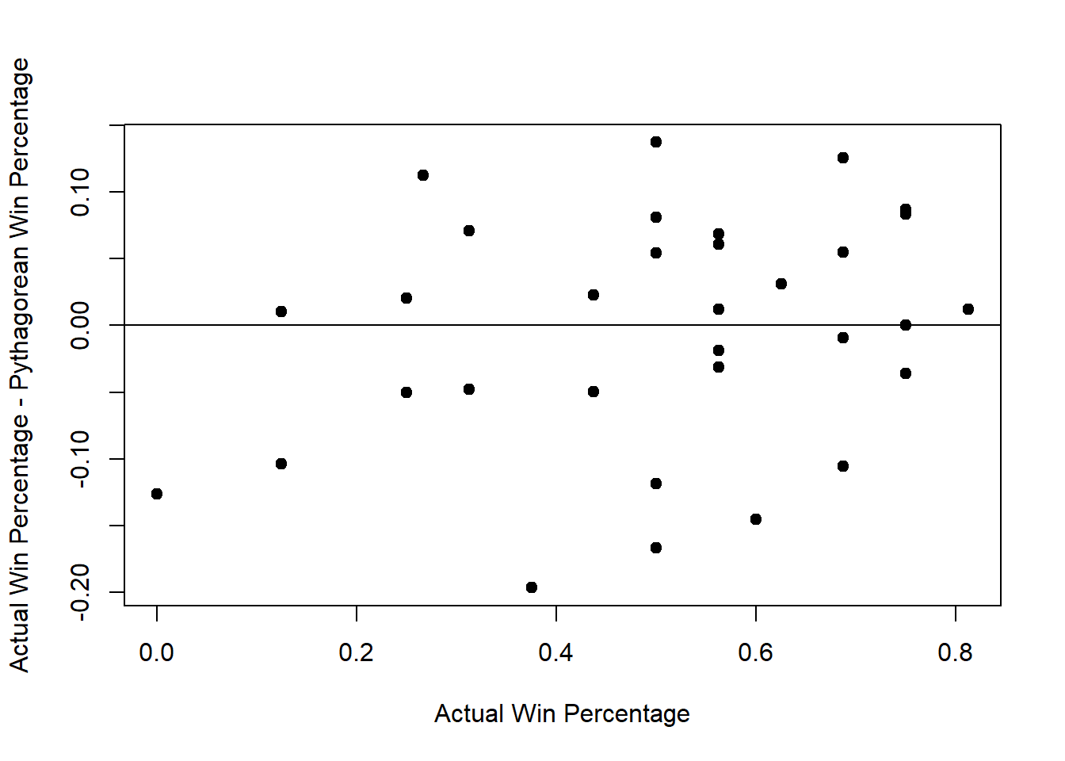
Discussion of Pythagorean Win Percentage
The biggest underachiever in the 2008 season were the Green Bay Packers. They had a Pythagorean win percentage of 0.57, but an actual win percentage of 0.375. This was an overprediction of .195.
The biggest overachiever were the Denver Broncos. They had a Pythagorean win percentage of 0.36, yet their actual win percentage was 0.5. This was an underprediction of 0.14.
Pythagorean win percentage tended to overpredict by wider margins than underpredict, as shown in the residual plot. For the most part, the Pythagorean win percentage were accurate, and there were 13 teams where the absolute difference between win percentage and Pythagorean win percentage was under 0.05.
The New York Giants were predicted almost perfectly, with a margin of 0.0001.

Slide 11
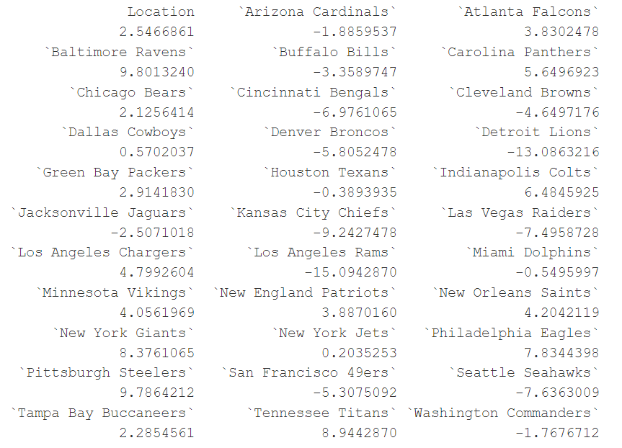
Calculation of Bradley-Terry Ratings

Slide 12
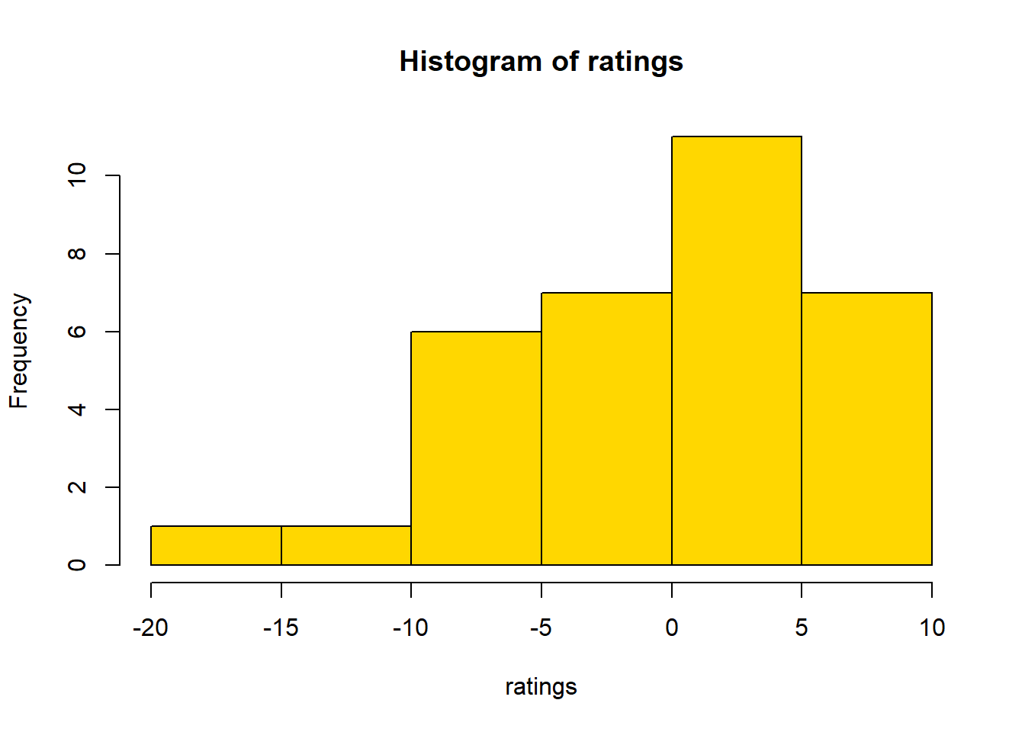
Discussion of Bradley-Terry Ratings
The best teams in the 2008 regular season were the Ravens, the Steelers, and the Titans with ratings of 9.8, 9.78, and 8.9, respectively. Interestingly, the Ravens did not win the AFC North, but based on the Bradley-Terry models they were the stronger team. The two worst teams were the Rams and the Lions, with ratings of -15.1 and -13.1 respectively. As seen in the histogram, these two teams were by wide margins the worst based on Bradley-Terry Ratings. The most average team in the 2008 season were the New York Jets with a Bradley-Terry Rating of 0.20.

Slide 13
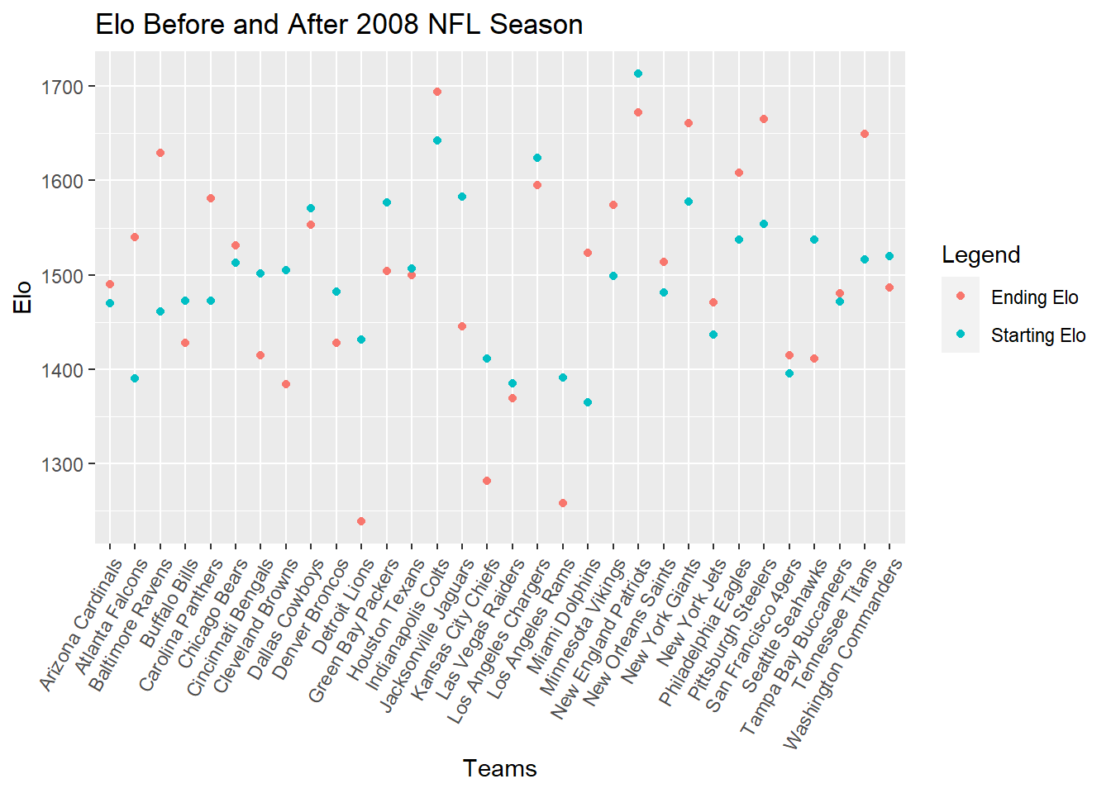
Preseason and Postseason Elo Ratings
The average team Elo is 1500
The standard deviation is 119
Ending Elos include playoff games

Slide 14
Discussion of Elo Ratings
Based on Elo ratings, the best team was the Indianapolis Colts, with an Elo rating of 1694. The worst team was the Detroit Lions, with a paltry Elo rating of 1239. It is worth mentioning that this is 2.2 standard deviations worse than average in the league, while the Colts were 1.6 standard deviations better than average.
The team that saw the largest Elo decrease over the season were the Detroit Lions, dropping 193 points. The team that increased the most in Elo were the Baltimore Ravens, jumping 168 points.
The expected playoff teams were the Colts, Patriots, Steelers*, Giants*, Chargers*, Panthers*, Vikings, and Cardinals*. Asterisks denote that the team actually won the division.

Slide 15
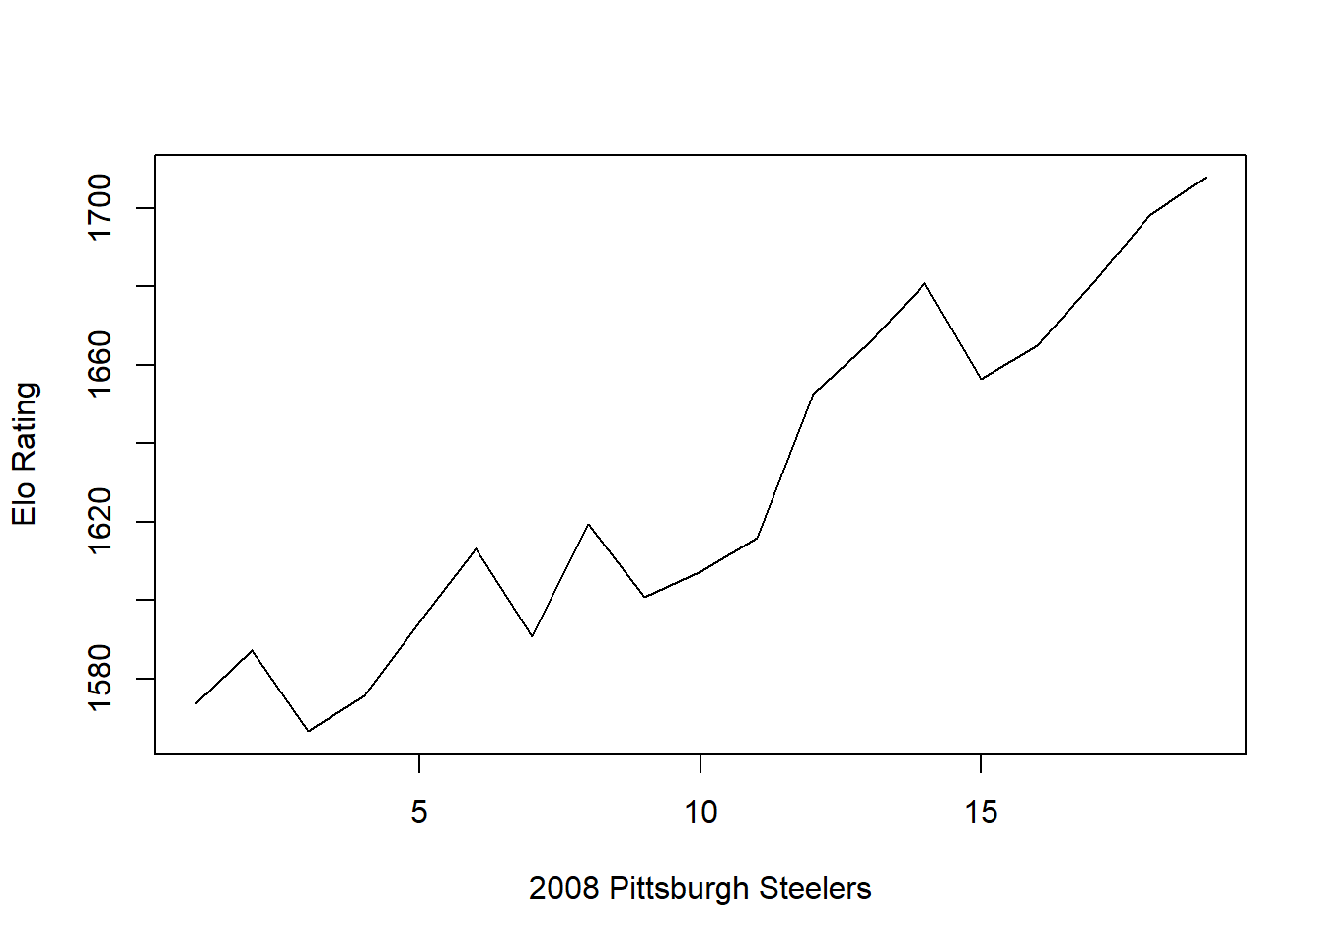
Elo Ratings of Steelers

Slide 16
Analysis of Steeler’s Elo Rating
The Steelers started the season with an Elo rating of 1554 and ended the season with an Elo rating of 1708. Although they had an early loss to the Eagles, they had a five-game win streak in the middle of the season including tough wins over the Patriots and the Ravens. This streak contributed to the Steelers’ massive increase in Elo over the season, where they climbed from 1601 all the way to 1681. Overall, the Steelers improved consistently throughout the season. Their largest decrease was their loss to the Titans, where they dropped 24.5 points. The largest gain was over the Cardinals in the Super Bowl, where they jumped 9.8 points to their high. In the regular season, their largest gain was in game 4 against the Ravens, where they gained 9.0 points.

Slide 17
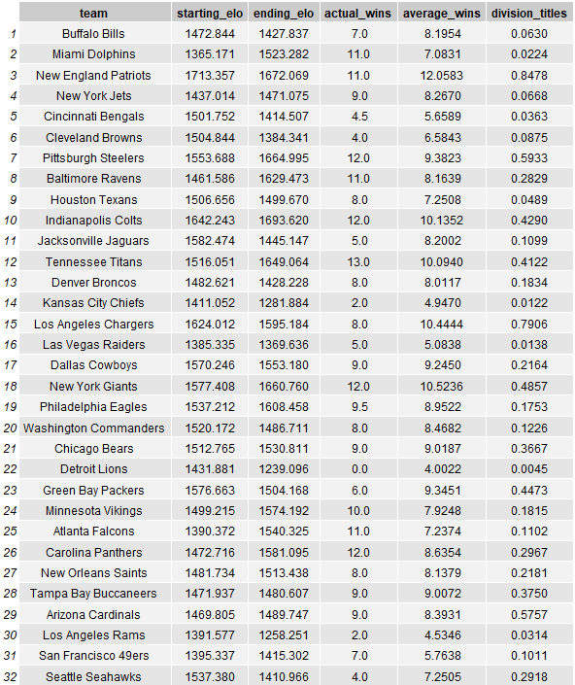
Simulated Regular Season Results
I simulated the 2008 season 10,000 times, and here are the results:

Slide 18
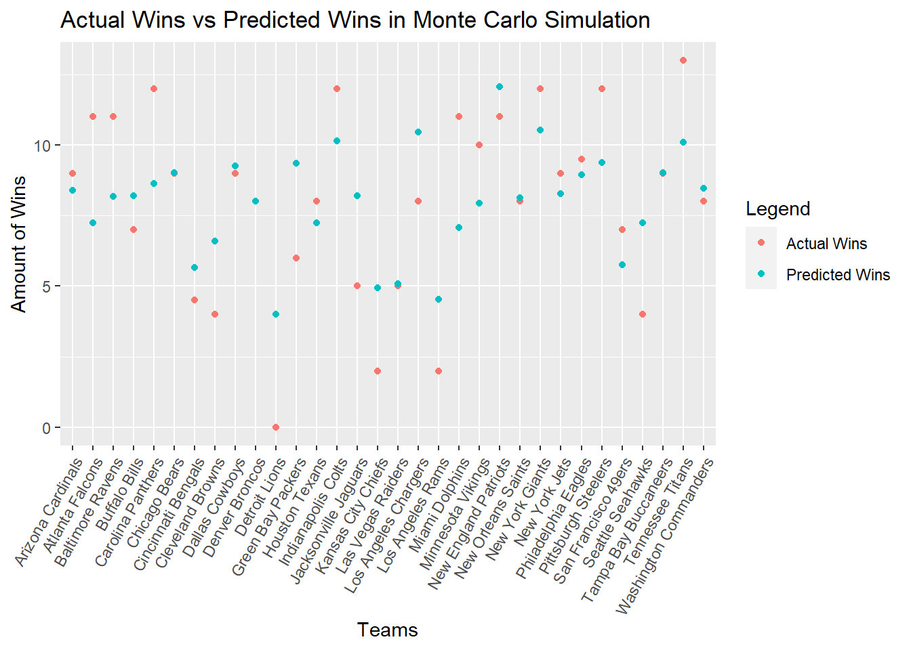
Comparison of Simulation and Actual Regular Season

Slide 19
Comparison of Simulation and Actual Regular Season
The Monte Carlo Simulation did well at predicting the season, as it predicted the win totals for 17 of the 32 teams in the NFL within two wins of the actual total. Additionally, the model correctly predicted four of eight division winners: the Chargers, Steelers, Cardinals, and the Giants. Interestingly, the team that was most favored to win its division, the Patriots at 84.8%, did not even qualify for a Wild Card spot in the playoffs.
There were three teams that were predicted remarkably close to their actual results. These were the Buccaneers, the Broncos, and the Bears, with a differences of 0.0072, 0.0117, and 0.0187, respectively. The Monte Carlo Simulation tended to predict teams with average win totals (around 8) most accurately, with teams that have lower win totals being consistently overpredicted, and then teams with high win totals generally being underpredicted.

Slide 20
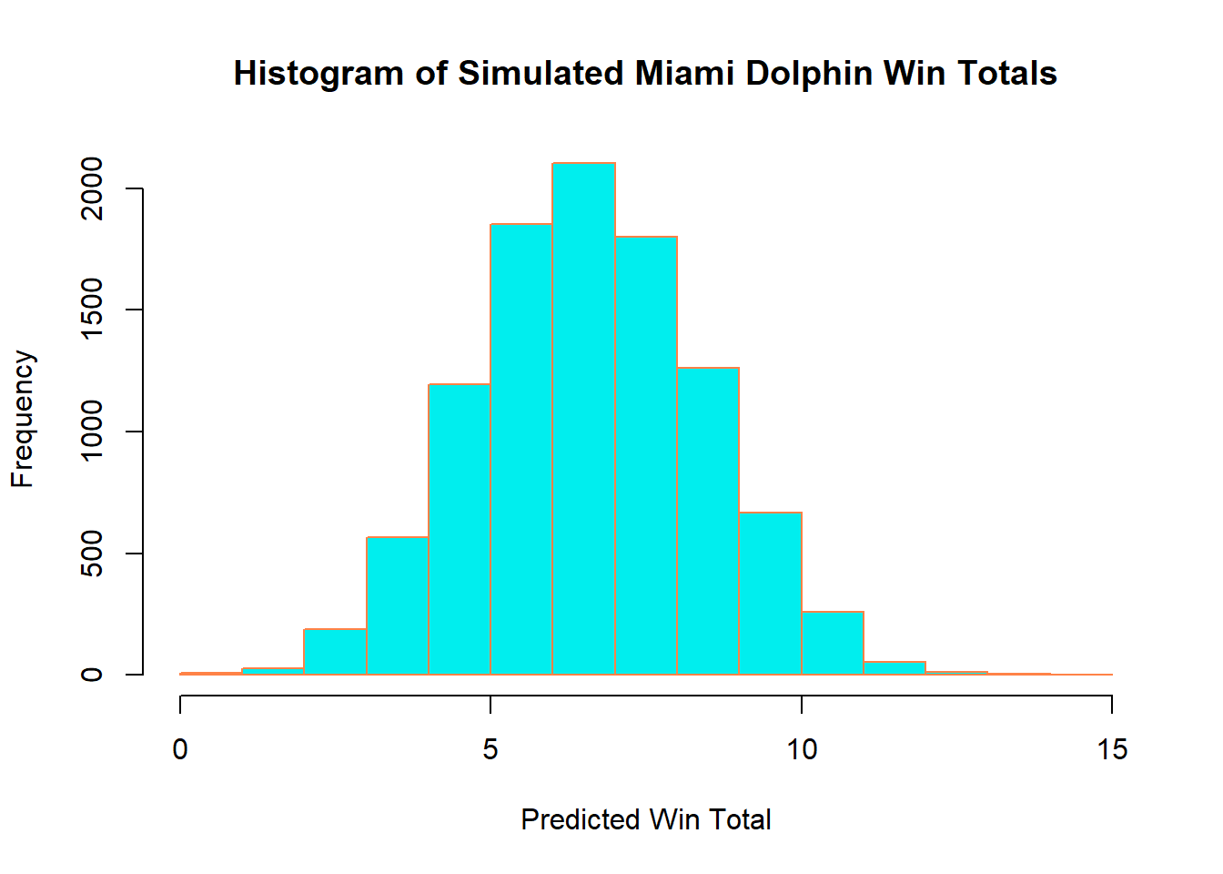
Analysis of Miami Dolphins
The Miami Dolphins were the biggest overachiever, outperforming the Monte Carlo Simulation by 3.9 points. Additionally, the Dolphins had only a 2.24% chance of winning its division, which was the fourth lowest chance according to the model, yet the Dolphins ended up winning the AFC East.
For some context, in 2007 the Dolphins ended with a 1-15 record, and had the lowest starting Elo in the entire league. This was the best single-seasoning turnaround in NFL history up to this point, which helps explain why the model underpredicted the Dolphin’s wins in the season.
The simulated win distribution is approximately normal, with an average just 7.

Slide 21
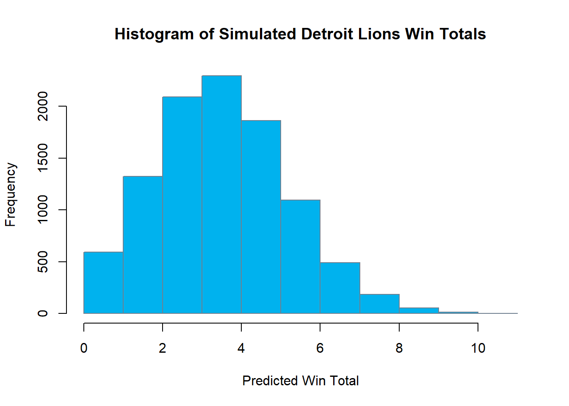
Analysis of Detroit Lions
The Detroit Lions were the biggest underachievers, underperforming the Monte Carlo Simulation by 4.00 points. The Lions ended with a 0-16 record, while the simulation predicted a 4-12 record. I hypothesize that the record did not predict a team to consistently underperform as much as the Lions did this season. Even with a below average starting Elo of 1432, with home field advantage the Lions would be expected to win at least a couple of games based on their team strength.
The win distribution shows a right skewed distribution, with an average of 4. The skewedness is a result of the cap of 0 wins on the lower bound, causing a less pronounced left tail for this below average team.

Slide 22
Conclusions
The 2008 NFL history was interesting to simulate, as two historic firsts occurred this season: the first 0-16 team in NFL history, and an 11-win team not making the playoffs. As expected, both the Pythagorean win percentage and Monte Carlo simulation overpredicted the winless Lions, and the Monte Carlo had the Patriots as a heavy favorite for winning the division (84.78%).
The Super Bowl winning Pittsburgh Steelers were slightly overpredicted in the Pythagorean win percentage model, but moderately underpredicted in the Monte Carlo simulation. This means that points scored and points allowed were more indicative of the Steelers’ success than their predicted Elo ratings over the season.
The Pythagorean win percentage overpredicted and underpredicted by smaller margins than the Monte Carlo simulation. The largest residual, 0.195, corresponds to 3.12 wins for the NFL’s 16 game schedule, which is noticeably smaller than the largest residual in the Monte Carlo simulation, 4.00.

Slide 23
Conclusions
Overall, I noticed a trend that teams that performed consistently from the year prior were much better at being predicted by the Monte Carlo Simulation. All teams that were predicted in the simulation by less than a 0.5 residual with its actual record had a median absolute difference of 18 points between their starting and ending season Elo.
This caused problems for teams that underperformed and overperformed; for example, the Patriots went undefeated and only lost the Super Bowl in 2007, thus their Elo rating was very high. They ended up underperforming by a bit over a point in the Monte Carlo simulation, but in the Pythagorean win percentage model, they performed similarly to what the model predicted. Similarly, the Dolphins were only underpredicted by 2 wins on the Pythagorean win percentage model (0.126 win percent residual), which is a smaller underprediction than the simulation’s 3.9 win residual.
This phenonomon helps explain the large residuals in the Monte Carlo simulation as compared to the Pythagorean win percentage, which generally had smaller overpredictions and underpredictions.

